Slide 1
For Segment 8 this shorter version is enough

Slide 2
Introduction to IoT: Core Concepts and Technology Fundamentals
What is the Internet of Things (IoT)?
The Internet of Things (IoT) is a network of physical objects -"things" - embedded with sensors, software, and other technologies for the purpose of connecting and exchanging data with other devices and systems over the internet. These devices range from ordinary household objects to sophisticated industrial tools.
Key Characteristics of IoT:
Connectivity: enabling communication between themselves and with cloud platforms
Data Exchange: provides valuable insights for decision-making and automation
Interoperability: The ability to work together and exchange information regardless of protocol.
Automation: can automate processes and without human intervention
IoT Network Topologies: Star, Tree, Mesh
Core Principles of IoT
1 Scalability
2 Security
3 Privacy
4 Intelligence
5 Integration

Slide 3
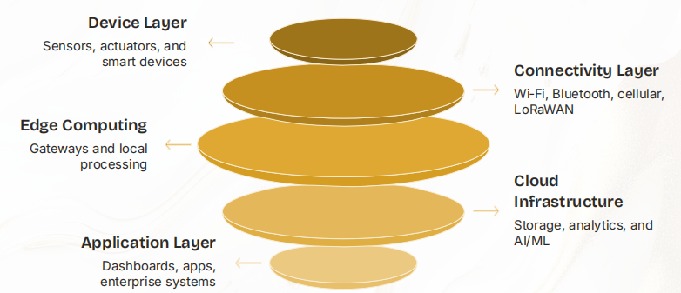
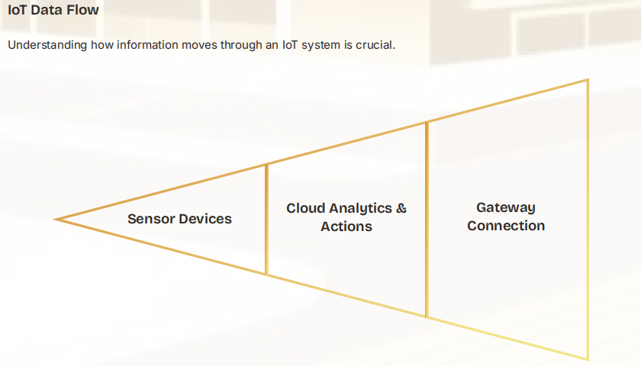
IoT Architecture: Core/Fundamental Components
Sensing & Actuation Layer: Physical objects equipped with sensors,actuators
Network & Communication Protocols: The communication layer connecting each other to the cloud
Data Processing & Management Systems: Data Processing infrastructure (cloud platforms, edge computing)
Application & User Interface: User Interface - Applications, dashboards, allowing users to interact and control devices.

Slide 4
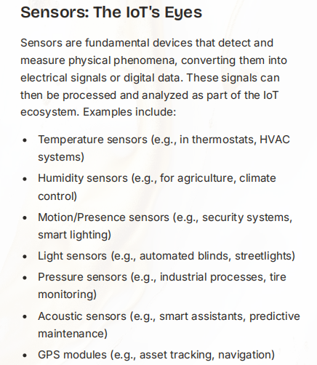
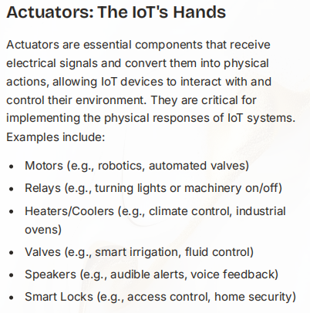

Slide 5
From M2M to IoT: Evolution and Value Chains
Machine-to-Machine (M2M) communication refers to the direct communication between devices using wired or wireless channels, without human intervention. Application: Utility Meters for electricity, gas, and water meters, Industrial Monitoring, Vending Machines etc.
Limitations Leading to IoT Evolution
(IoT) represents a significant evolution from Machine-to-Machine (M2M) communication,
fundamentally transforms how data is collected, processed, and utilized to create new value chains.
M2M uses Point-to-Point Communication but IOT provides Internet Connectivity
M2M uses Data Telemetry but IOT uses Data Analytics, ML & AI
M2M is applied for limited vendors but IOT is applied for Real-time Processing for vast data & purpose
Key Characteristics of M2M
Direct Device Communication.
Automated Data Exchange
Minimal Human Intervention
Proprietary Nature
Specific Applications
M2M Architecture Components
M2M Devices
Communication Networks
M2M Middleware
M2M Applications

Slide 6
IoT Infrastructure
IoT infrastructure refers to the physical and virtual components that support the entire IoT ecosystem, from device connectivity to data management and application delivery. It forms the backbone for data flow and processing.
Key Infrastructure Components
Edge Devices: The "things" in IoT, including sensors and actuators.
Gateways: Bridge the gap between edge devices and the cloud.
Cloud Platforms: Provide robust services for data storage, analytics and application.
Data Centers: Centralized facilities for hosting cloud platforms.
Infrastructure Layers
01 Device Layer
02 Connectivity Layer
03 Data Processing Layer
04 Application Layer
Network Architecture
IoT network architecture defines how devices are connected and how data flows through the system.
Network Design Considerations
Scalability
Reliability
Security
Latency
Power Consumption
Common Network Topologies
Star Topology
Mesh Topology
Tree Topology
Hybrid Topologies

Slide 7
Communication Protocols
Communication protocols dictate the rules for data exchange within the IoT network, devices, gateways, and cloud platforms. Protocol selection depends on factors like range, power consumption, and data rates.
Short-Range Communication Protocols:
Wi-Fi: High bandwidth, suitable for local areas
like smart homes, offices.
Bluetooth/BLE: Low power, short range, ideal for
wearables, personal devices, and small sensor networks.
Zigbee & Z-Wave: Low power mesh networking
protocols, commonly used for reliable smart home
automation, forming local area network
architecture.
NFC (Near Field Communication): Very short_x0002_
range, secure, used for payments, access control,
and tag reading.
Long-Range (LPWAN) Communication Protocols:
LoRaWAN & NB-IoT: Low power, long-range
solutions for wide-area deployments with small
data packets (e.g., smart cities, agriculture).
Cellular (2G/3G/4G/5G): High bandwidth and
range, reliable for mission-critical applications and
mobile IoT devices. 5G offers ultra-low latency,
crucial for next-gen IoT infrastructure.
Satellite: Global coverage, essential for remote
asset tracking and areas without terrestrial network
infrastructure

Slide 8
IoT Applications Across Domains
Smart Homes & Buildings
Smart Agriculture
Smart Cities
Wearable Technology
Industrial IoT (IIoT)
Healthcare & RPM (Remote Patient Monitoring)
Transportation & Logistics
Energy & Utilities
Retail & Supply Chain
Environmental Monitoring
Education

